Slide 1
Red Wine Case Study
Nonhlanhla Linda Luphade

Slide 2
Outline
Business Understanding
Data Understanding
EDA Summary
Modelling
Recommendations

Slide 3
Business Understanding
The price of red wine depends on the concept of wine appreciation from wine tastes.
Thus, the quality of wine is subject to human biases and the process is time consuming.
Quality of wine based on physicochemical properties.
It would be beneficial to find a way to relate human quality of tasting to the chemical properties so that certification, quality assessments, and assurance procedures are efficient and controlled.
The objective of this case study is to determine which feature are important in determining wine quality and to find efficient and fair way to help the wine industry to predict wine quality.

Slide 4
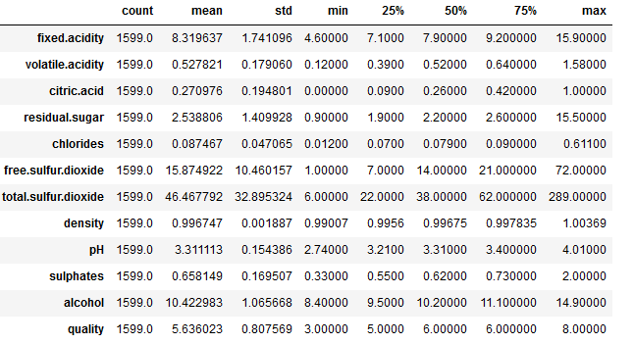
Data Understanding
The data set consists of 12 variables.
All the variables are numeric; however, the response variable (quality) is categorical or discrete.
The image gives a summary of all the variable in the data set.

Slide 5
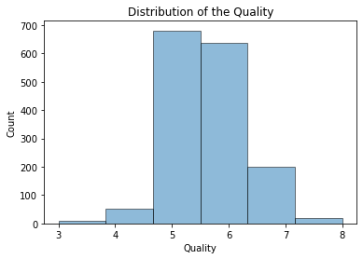
Univariate Analysis of variables: Quality
From the graph we can observe that there are a few bad and good quality wines in this data set. (i.e., unbalance)
The data contains mostly wines with a quality rate of 5 and 6.

Slide 6

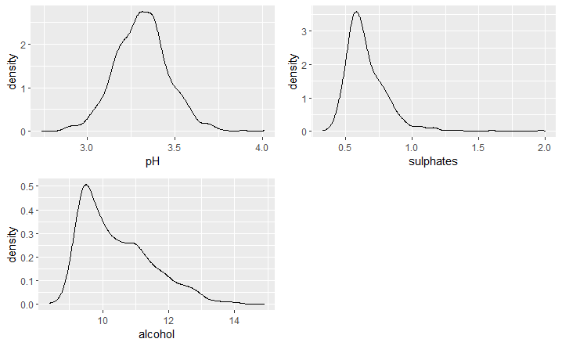
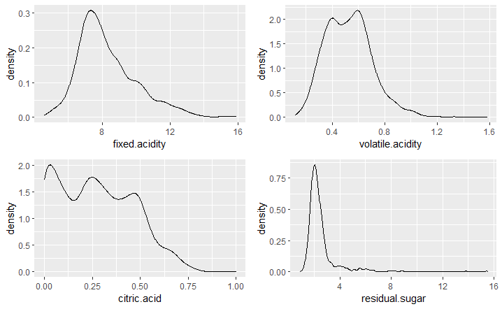
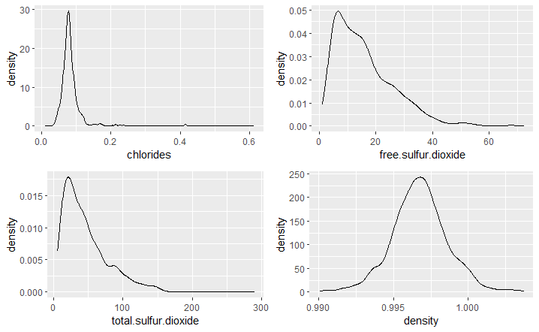

Are there any normal distributed variables?
The only variables that seemed to be normal distributed were density and pH, thus, a normality test was performed to assess if that was true.
None of the variables are normal distributed.
Most of the variables are skewed to the left which is due to outliers.

Slide 7
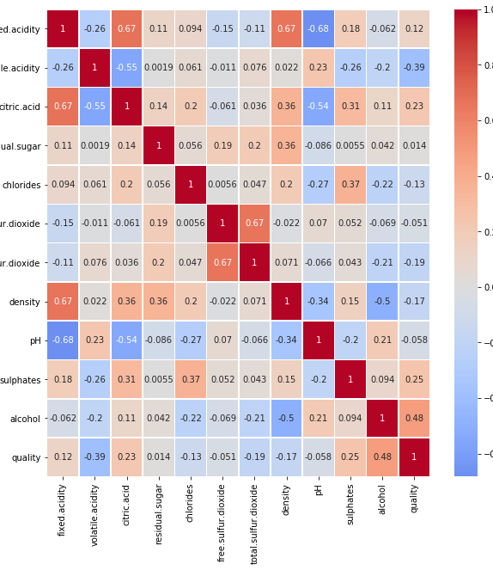
Data Exploration: Correlation
To explore the relationships between variables, a correlation analysis was performed.
The percentage of alcohol and the volatile acidity are the most relevant correlations among other variables.
The wine quality is positively correlated to alcohol and negatively correlated to volatile acidity which makes sense because volatile acidity is responsible to the vinegar taste in the wine.
sulphates, citric acid, fixed acidity are also positively corelated to quality.
Interesting relationships observed:
Fixed acidity and citric acid
Fixed acidity and pH
Fixed acidity and density

Slide 8
Data Exploration: Correlation
Sulphates, citric acid, fixed acidity are also positively corelated to quality., however, they are not that relevant.
Interesting relationships observed:
Fixed acidity, volatile acidity and citric acid are different types of acids. Therefore, they are all related to each other.
Fixed acidity and pH – lower values of pH correspond to high acidity.
The relationship between density and alcohol, residual sugar, fixed acidity and citric acid.

Slide 9
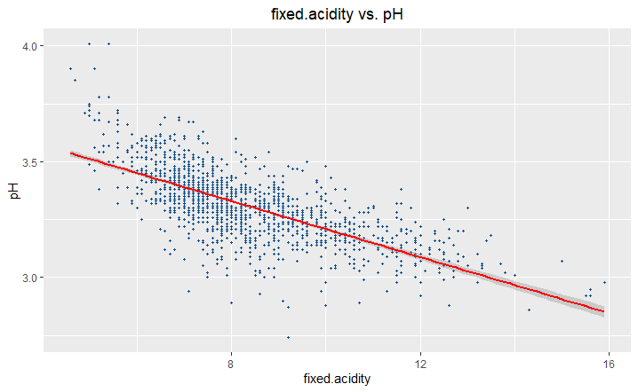
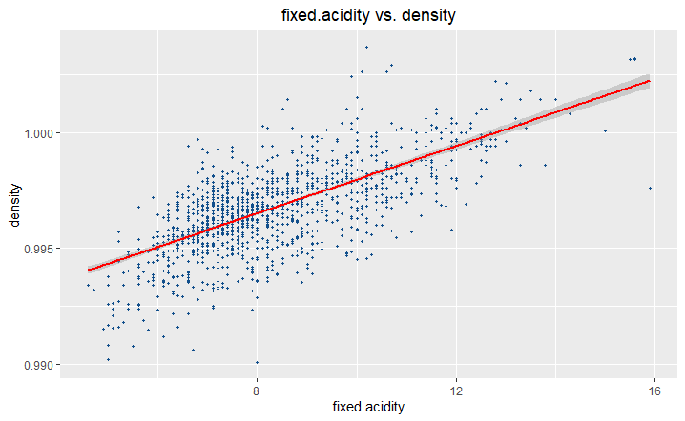
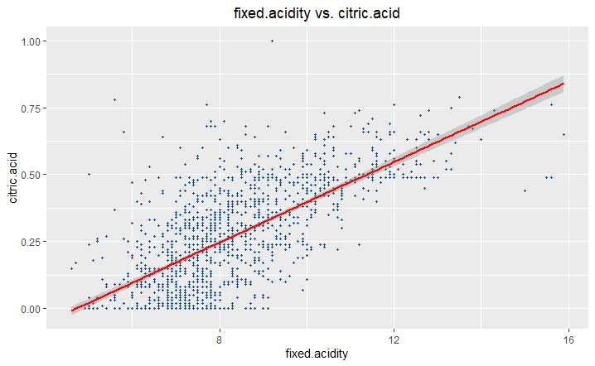
Visualization of interesting relationships

Slide 10
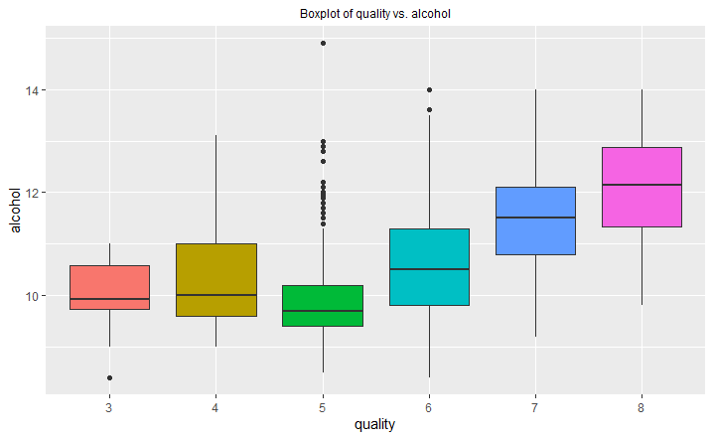
Alcohol and Quality
As expected, there is a relationship between the percentage of alcohol and quality.
Different levels of wine are assigned when the wine has 11% alcohol.
Wines with high alcohol percentage are assigned better quality.

Slide 11
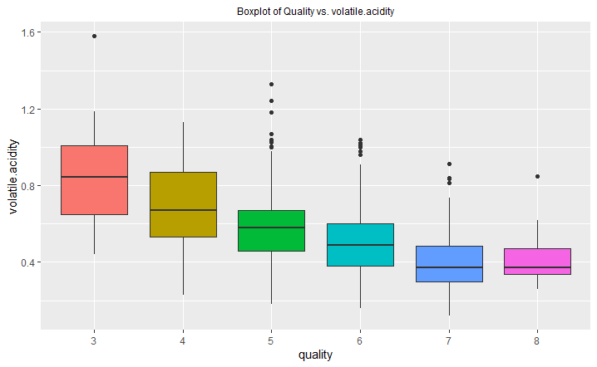
Volatile acidity and Quality
In the diagram show we can observe the negative relationship between quality and volatile acidity.
Wines with higher volatile acidity have the lowest quality ratings.
Wines without less of the vinegar taste are scored highly.

Slide 12
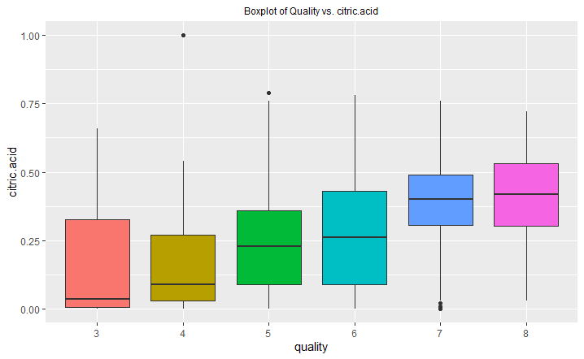
Citric Acid and Quality
The is a positive relationship between citric acid and quality.

Slide 13
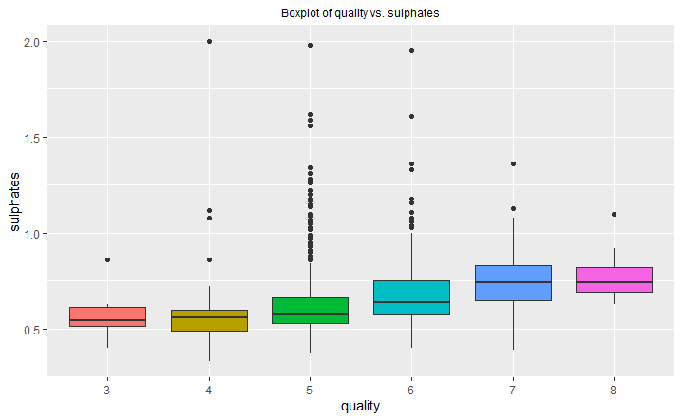
Sulphates and Quality
Sulphates have somewhat positive relationship with quality.
Sulphates are used to decrease the vinegar taste cause by high volatile acidity, thus, the negative relationship between sulphates and volatile acidity.

Slide 14
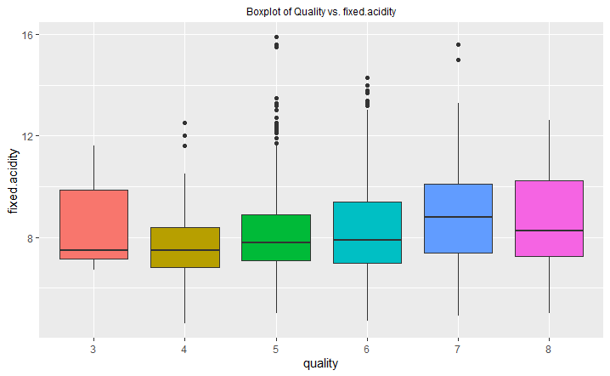
Fixed Acidity and Quality
There is no variation in quality, thus, no significant relationship.

Slide 15
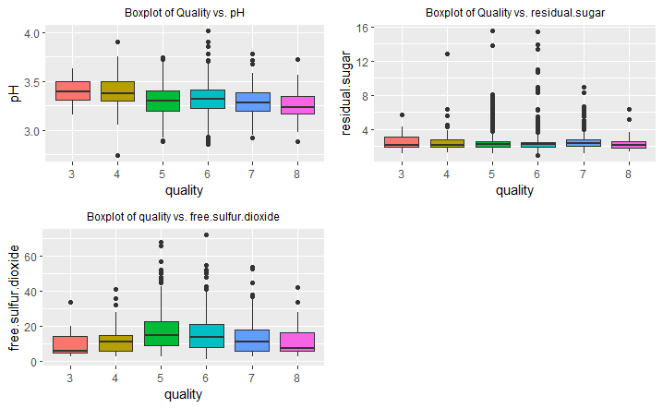
Other variables with no variation
There is no significant relationship between wine quality and these variables.

Slide 16
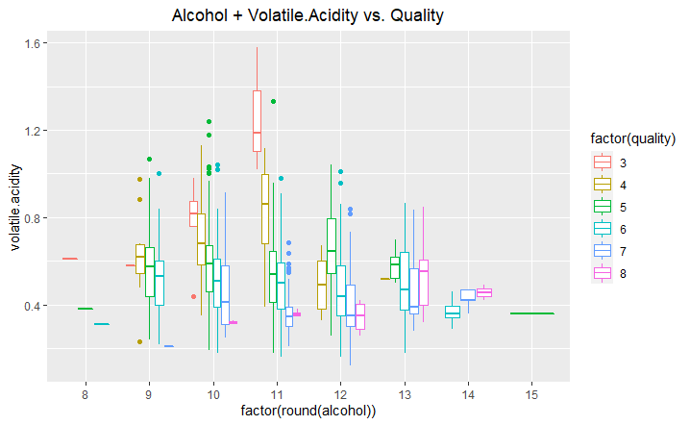
The relationship between alcohol, volatile acidity, and quality
A clear distinction between the different quality scores is observed for wines with 11% and above alcohol.
High volatile acidity is one of the determinant for bad wine.
Low quality wines have an alcohol percentage of less than 11%.

Slide 17
Modelling
For modelling regression and classification models were considered.
For regression:
Multiple linear regression
Random Forests
For classification:
Decision Trees
PCA + Decision Trees
Data:
11 explanatory variables
1 response variable

Slide 18
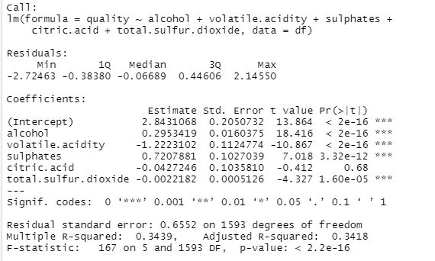
Modelling: Linear Regression
A linear regression model was built to estimate wine quality and the five most important attributes (alcohol, volatile acidity, sulphates, total sulfur dioxide, and citric acid).
The important variables were selected based on the EDA and the correlation analysis.
The model performance was not good with R-squared of 34.4%.
Citric acidity is a non-significant variable in this model thus it was removed in the next model.

Slide 19
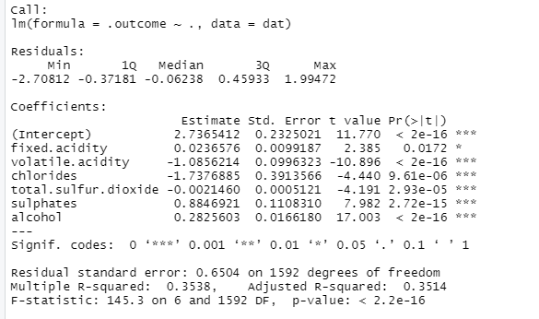
Modelling: Linear Regression
A linear regression model was built to estimate wine quality and the four most important attributes ().

Slide 20
Variable Reduction and Transformations.
For the second model, the lasso method is used which performs both variable selection and regularization.
The result subset has 6 variables.

Slide 21
Modelling: Linear Regression
The second model is better than the first, however, it is not good enough. The R-square is still too low.
The multiple linear regression models are not good because of:
Data is unbalanced
Low correlation
Target variable coverage
Biases in the target variable

Slide 22
Results
 | Best Linear Regression Model | Random Forest Model
R-Squared | 35.3% | 48.5%
RMSE | 65.2% | 58.4%
MAE | 50.6% | 42.2%
The best regression model is the random forest model because it has a high R-squared value.

Slide 23
Classification
The data was standardized to equalize the range of data.
Split data into training and testing sets.
A decision tree model is built and evaluated using the testing set.

Slide 24
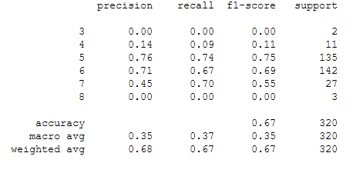
Modelling: Classification with decision Trees
The results show us that overall accuracy is high.
However, the f1 score is low for good quality wines and bad quality wines.

Slide 25
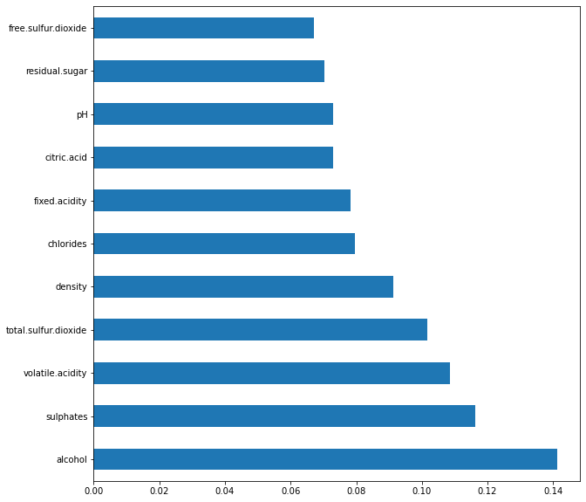
Modelling: Feature Importance
The most important features based on regression and classification are alcohol, sulphates, volatile acidity and total sulfur dioxide.

Slide 26
Model Selection
The best model for this data set is a classification model.
It is the perfect fit because it has a higher prediction accuracy score which means it will be able to work for our business model.

Slide 27
Conclusion
By exploring the data and finding the best model, we can see that good quality wines have higher levels of alcohol on average, have a lower volatile acidity on average, medium to high levels of sulphates on average.
Meanwhile, low quality wines tend to have low values of citric acid.

Slide 28
Limitations
The main problem was that the data set was unbalanced which made it hard to find out which variables influence low- or high-quality wines.
The data was too narrow, more information about the wines is needed to built a better solution.

Slide 29
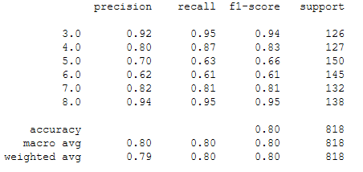
Recommendations
Example of results from balanced target data set.
We can use other method to balance the target variable such as SMOTE.
Use of other machine learning algorithms such neural network or improving existing methods.
Selection of appropriate features.

